Slide 1

Food Donation
UCE2021507 Rajasi Barapatre
UCE2021509 Anushka Chaudhari
UCE2021510 Sanika Chavan
UCE2021517 Gouri Dhampalwar

Slide 2

Problem Statement
To develop a web application through which food donations can be done. A request is to be made by a user to either donate or receive food. The requests are accepted by the admins of the respective locality and accordingly the food is donated to a person who has made a receiving request. (Using JavaSwing, SQL queries)

Slide 3
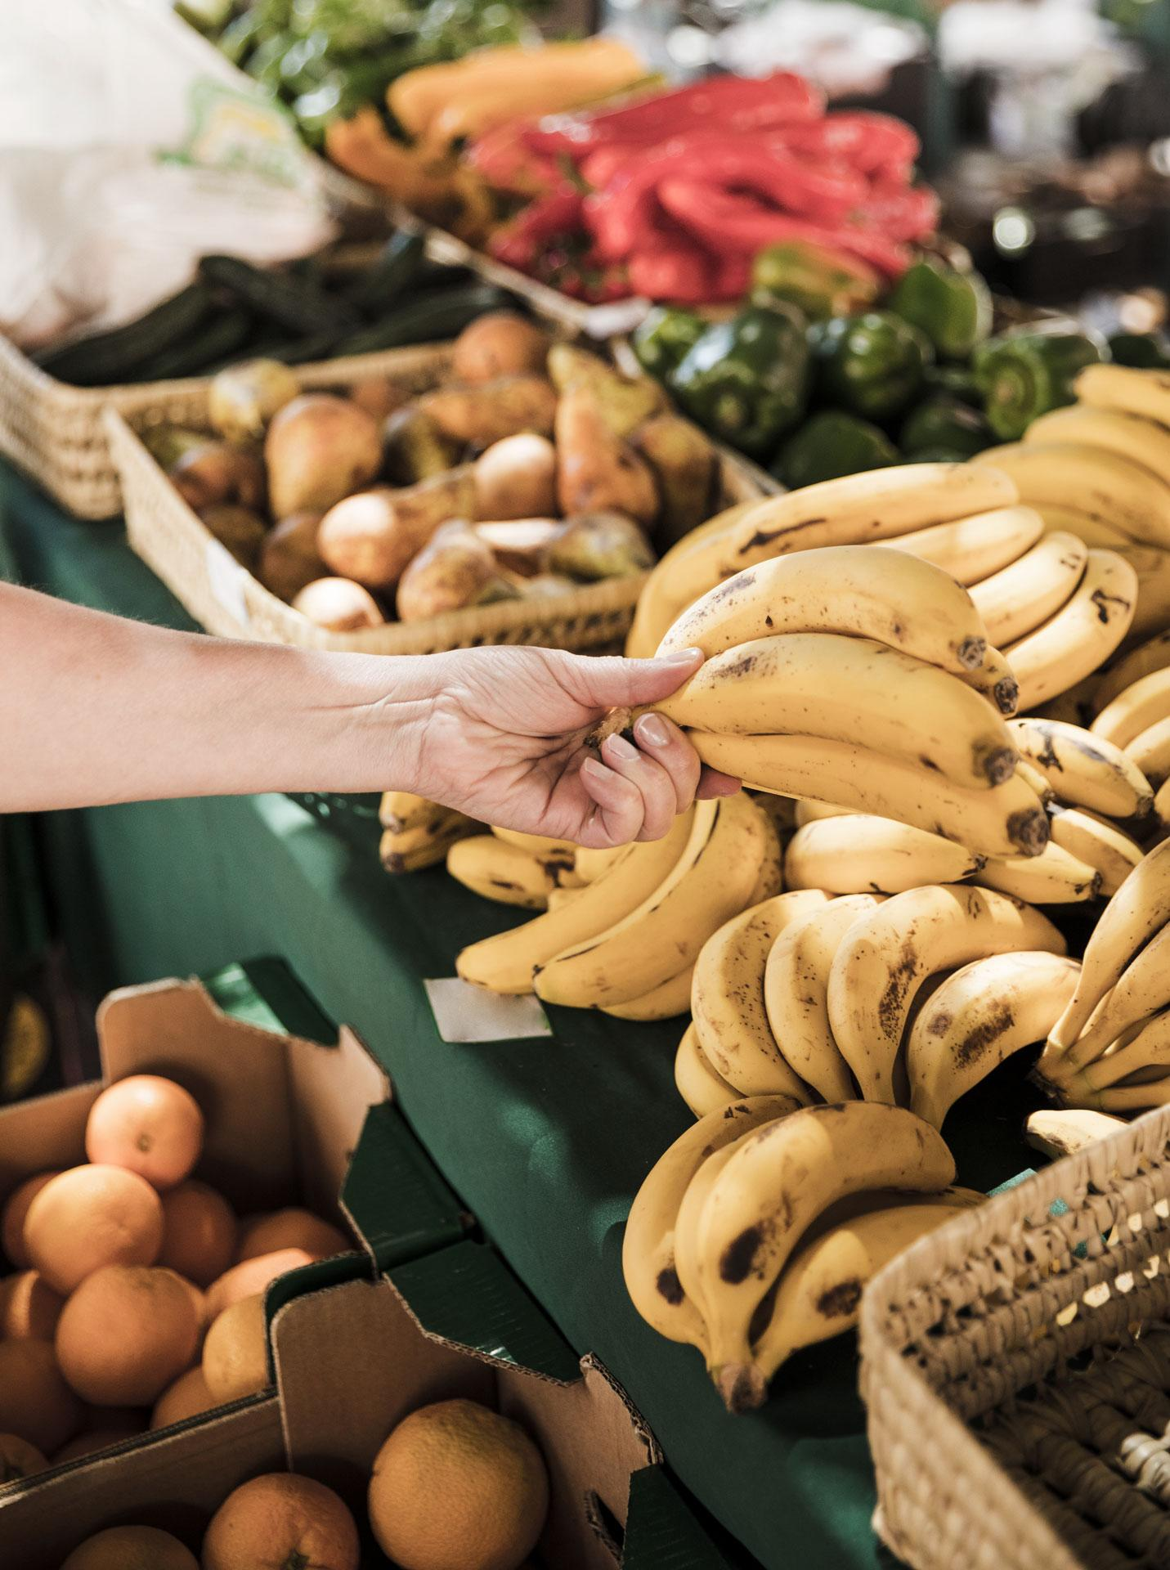
Database requirements :
01
02
Donor information
Receiver Information
03
04
Order completed
Conclusion
The information of a person who wishes to donate is collected.
The information of a person who wishes to collect the food .
Matching based on location and category is done , accordingly food is passed on from donor to receiver.
A status is updated indicating whether the food is donated or is pending.

Slide 4
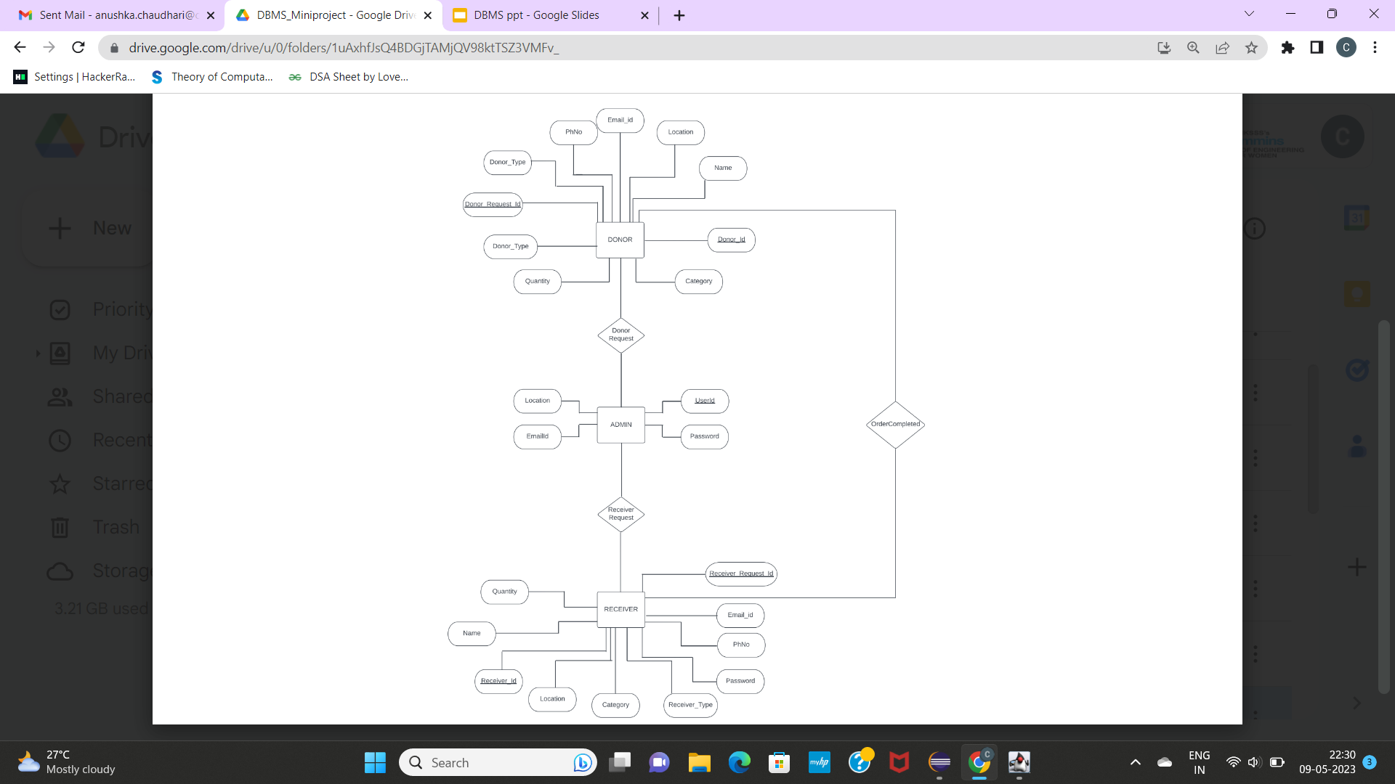

Slide 5
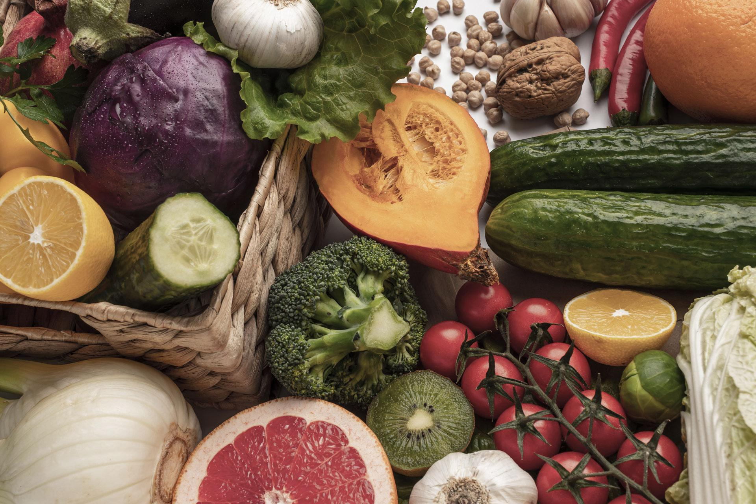
Normalization

Slide 6
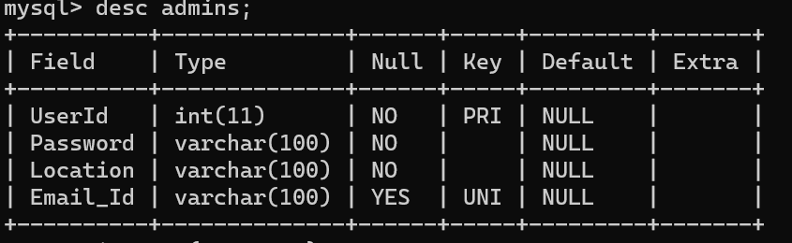
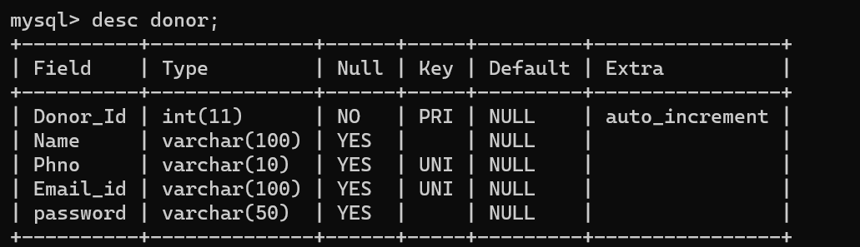
Tables:

Slide 7
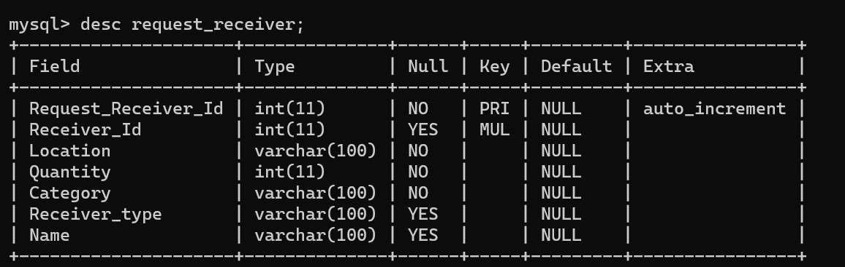
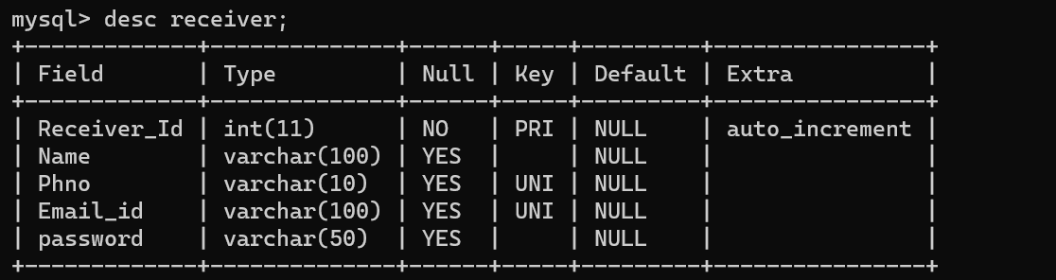

Slide 8
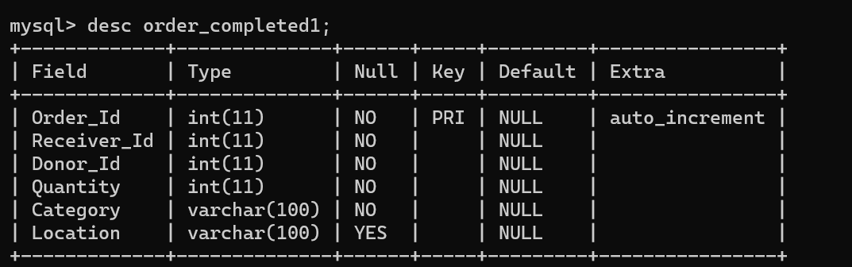
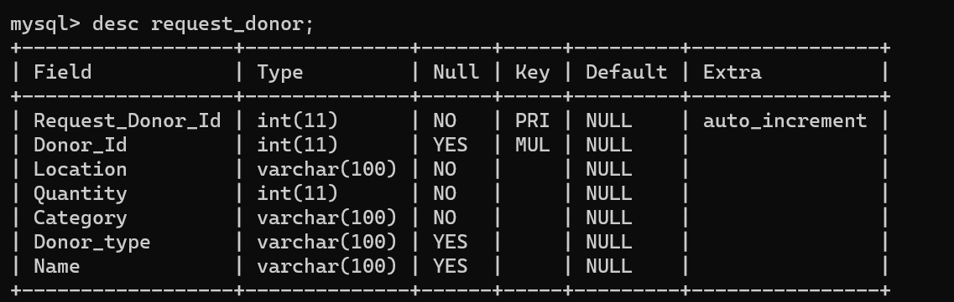

Slide 9

1 NF
Donor :
Receiver:
Donor_Id | Email
Receiver_Id | Email
Donor_Id | PhNo
Receiver_Id | PhNo
Admin:
User_Id | Email

Slide 10
2 NF
Donor :
Composite primary key=Donor_id+Donor_request_Id
FD’S are :
Donor_Id -> Name
Donor_request_Id -> Quantity
Donor_request_Id -> Location
Donor_request_Id-> Category
Donor_request_Id -> Donor_Type
Donor_request_Id | Quantity | Donor_Type | Category | Location
Donor_ID | Name
Donor_ID | Donor_request_Id

Slide 11
2 NF
Receiver:
Composite primary key=Receiver_id+Receiver_request_Id
FD’S are :
Receiver_Id -> Name
Receiver_request_Id -> Quantity
Receiver_request_Id -> Location
Receiver_request_Id-> Category
Receiver_request_Id -> Donor_Type
Receiver_request_Id | Quantity | Receiver_Type | Category | Location
Receiver_ID | Name
Receiver | Receiver_request_Id

Slide 12
3 NF
As there are no Transitive Functional dependencies ,the tables are in 3NF
Donor :
Donor_request_Id | Name | Quality | Donor_Type | Category | Location
Receiver :
Receiver_request_Id | Name | Quality | Receiver_Type | Category | Location

Slide 13

Objective Satisfied
An easy connection between a donor and receiver is established.

Slide 14
Thankyou

